Slide 1

Enterprise Risk Analytics
Assel Kassenova, Timur Bektur, Alpamys Tauken, Manas Verma
MET AD 616

Slide 2
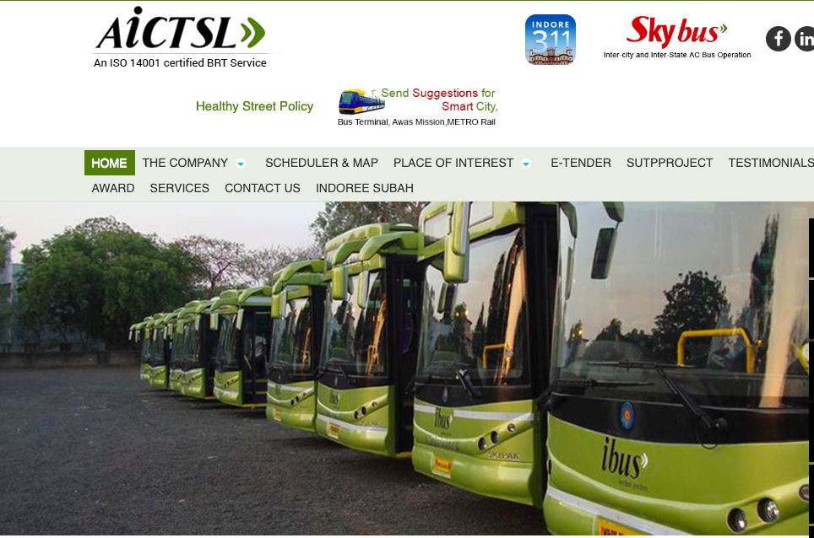
Case overview
Atal Indore City Transport Services Limited (AICTSL) is a company established by the Indore Municipal Corporation to provide public transport services in Indore, India. The company operates several bus routes in the city, including the first line from Rajiv Gandhi Square to Niranjpur Square.

Slide 3

Public transportations available in an urban setting
Buses
Metro, subway, and underground
Light rail or tram systems
Commuter rail:
Bus Rapid Transit (BRT)
Trolleybuses
Shared mobility services like Uber and Lyft
Taxis and Auto-Rickshaws
Ferries and water taxis
Aerial trams/cable cars
Auto rickshaws, three-wheelers

Slide 4
ADVANTAGES
Grade separated provides high sense of safety and saves travel time
BRTS lanes do not interfere with mixed traffic
Designated curb side bus-only lanes improve BRT travel time making buses competitive with automobile
Converted High Occupancy Vehicle (HOV) lanes, allow buses to operate faster, more reliably and more safely than buses in mixed traffic lanes
DISADVANTAGES Construction of graded lanes has high capital value
Lanes with no interference may not be attainable always.
Implementation of new bus lanes with street widening may displace parking and pedestrian paths
Since buses share lane with HOV’s, automobiles may impede bus operations. This make HOV lanes less efficient than bus only lanes.

Slide 5
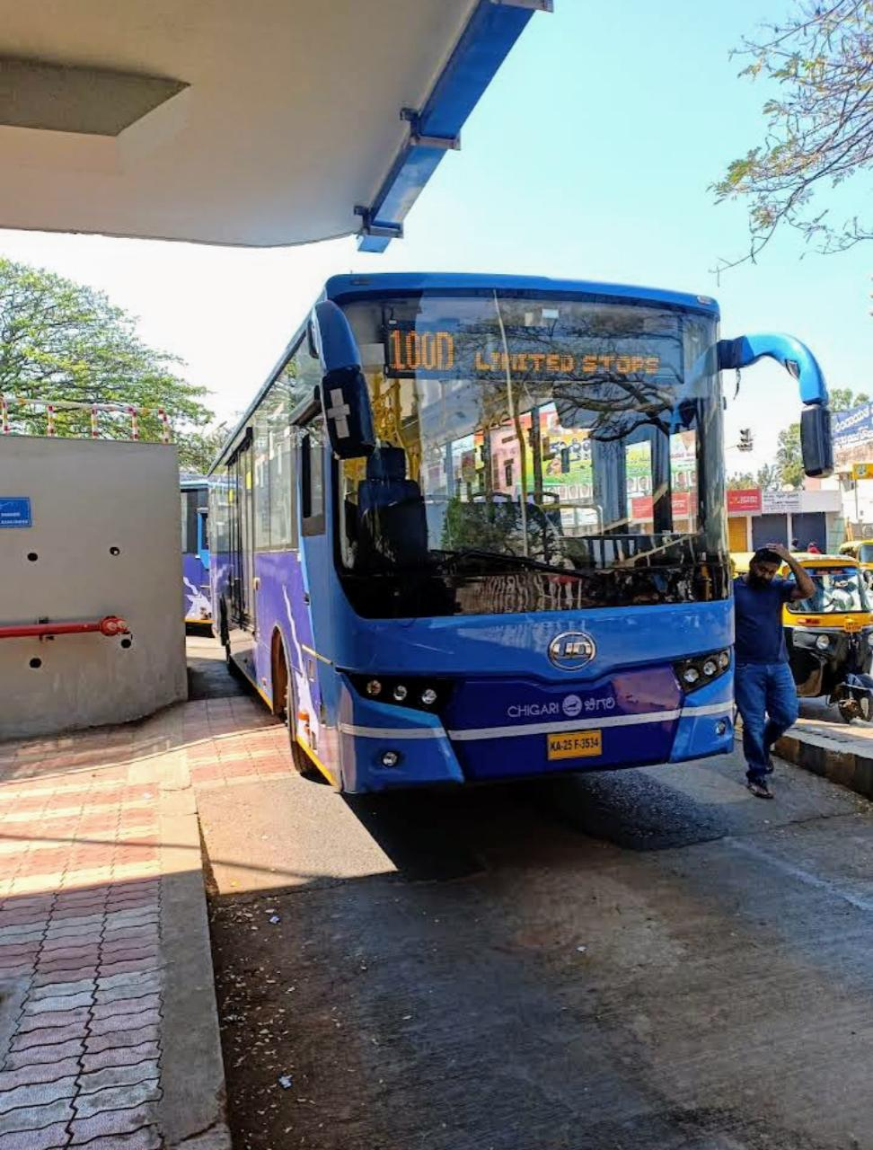
Challenges encountered in developing
and operating a BRTS
Infrastructure and planning
Land and right-of-way
Financing
Integration with current transportation systems
Traffic management
Public support and ridership:
Operational efficiency
Environmental and social issues
Repair and maintenance
Training and managing staff

Slide 6
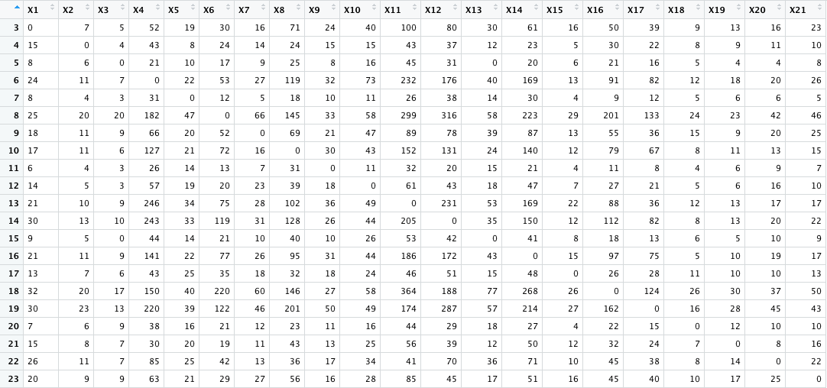
Determine appropriate frequency for each route of BRTS
Route: from Rajiv Ghandi to Niranjanpur SQR
Used R
Created Matrix
Sum Rows, subset Sum of columns
Route: from Niranjanpur SQR to Rajiv Ghandi

Slide 7
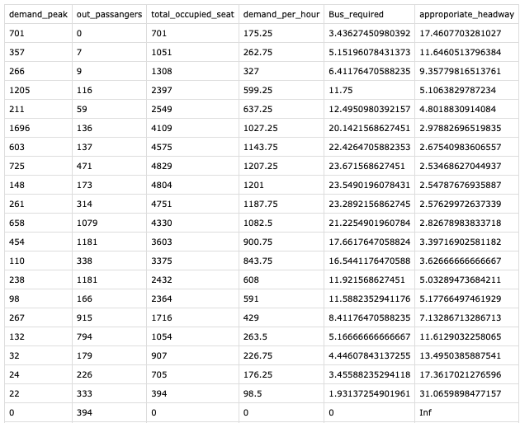
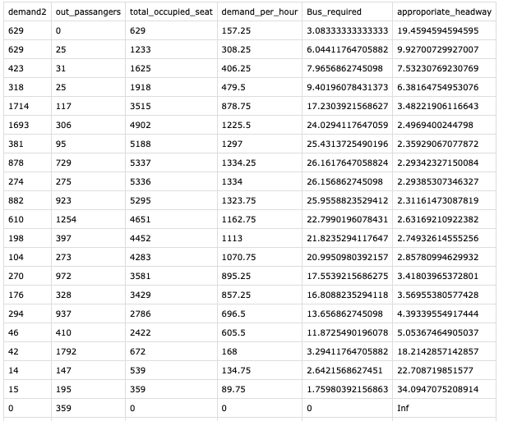
Peak hours appropriate headway
Route: from Rajiv Ghandi to Niranjanpur SQR
Route: from Niranjanpur SQR to Rajiv Ghandi

Slide 8
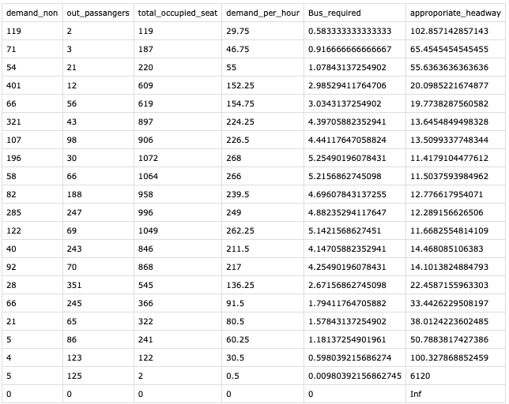
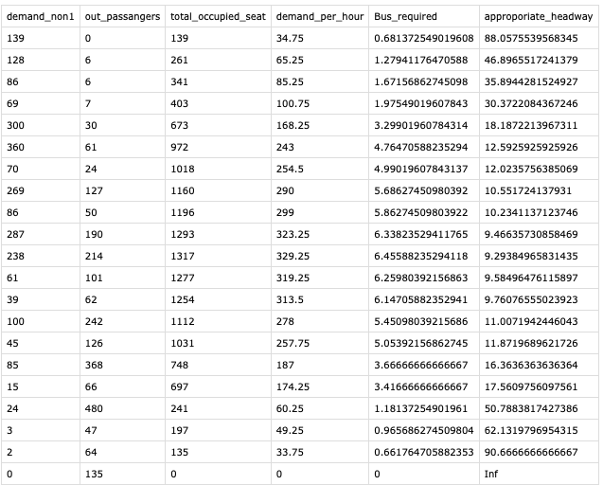
Non - Peak hours appropriate headway
Route: from Rajiv Ghandi to Niranjanpur SQR
Route: from Niranjanpur SQR to Rajiv Ghandi

Slide 9
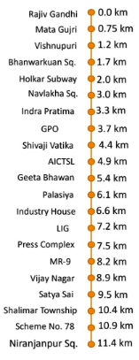
Route: from Rajiv Ghandi to Niranjanpur SQR
PEAK HOURS Lowest Headway for peak hours is 3 min, between stop Naviakha SQ to AICTSL
NON-PEAK HOURS Lowest Headway for non peak hours is 11 min, between 2 stops GPO and Shivaji Vatika

Slide 10
Route: from Niranjanpur SQR to Rajiv Ghandi
PEAK HOURS Lowest Headway for peak hours is 3 min, between stop Naviakha SQ to Industry House
NON-PEAK HOURS Lowest Headway for non peak hours is 9 min, between stop AICTSL to Industry House

Slide 11
Bus scheduling and frequency rote deployment plan
Route A:
Desired frequency: 15 minutes
Operating hours: 6 am to 11 pm = 17 hours
Number of trips per hour: 60 / 15 = 4
Number of trips per day: 4 * 17 = 68
Number of buses required per day: 68 / 12 = 5.67 (round up to 6)
Route B:
Desired frequency: 30 minutes
Operating hours: 7 am to 10 pm = 15 hours
Number of trips per hour: 60 / 30 = 2
Number of trips per day: 2 * 15 = 30
Number of buses required per day: 30 / 12 = 2.5 (round up to 3)
Based on the above calculations, we need 6 buses for Route A and 3 buses for Route B
The demand ranges from 120 to 1696 passengers, and the number of buses required ranges from 2 to 202. The appropriate headway ranges from 2.5 to 17.5 minutes, and the desired headway ranges from 30 to 191 minutes.
The data suggests that as the demand for the bus service increases, the number of buses required and the appropriate headway also increase. The desired headway and desired number of buses, however, do not always increase with demand.

Slide 12
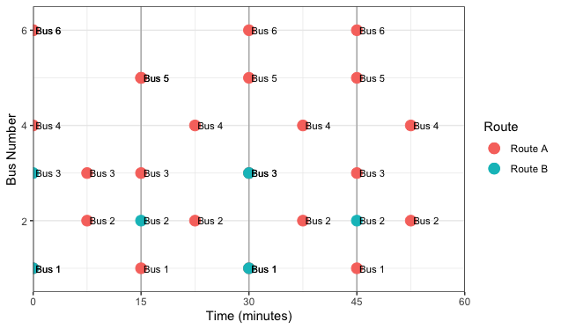
Bus scheduling and frequency rote deployment plan
Route A:
Since we need 6 buses for Route A, we can deploy them in a cyclic manner with a gap of 15 minutes. The first bus can start at 6 am and make 12 round trips throughout the day, with a gap of 15 minutes between each trip. The last bus can complete its final round trip by 11 pm.
Route B:
Since we need 3 buses for Route B, we can deploy them in a cyclic manner with a gap of 30 minutes. The first bus can start at 7 am and make 6 round trips throughout the day, with a gap of 30 minutes between each trip. The last bus can complete its final round trip by 10 pm.
These deployment plans assume that all buses operate at the same speed and there are no unexpected delays or disruptions. It is also important to have some buffer time between trips to account for unexpected delays and ensure that the buses run on time.

Slide 13
Bus scheduling and frequency rote deployment plan
The peak hours for Route A are from 6:00 am to 9:00 am and from 5:00 pm to 8:00 pm, while the non-peak hours are from 9:00 am to 5:00 pm and from 8:00 pm to 11:00 pm.
The demand per hour during peak hours is 600 passengers per hour, and during non-peak hours it is 300 passengers per hour. The capacity of each bus is 60 passengers.
For Route B, the peak hours are not explicitly defined, but it is stated that the demand per hour during peak hours is 450 passengers per hour, and during non-peak hours it is 225 passengers per hour. The capacity of each bus is again 60 passengers.
For example, we could deploy 10 buses during peak hours and 4 buses during non-peak hours, with a gap of 15 minutes between each bus during peak hours and a gap of 30 minutes between each bus during non-peak hours.

Slide 14
How to enhance BRTS reliability and safety while minimizing costs?
Implement a real-time scheduling system
Use predictive analytics
Implement traffic management strategies
Improve communication with passengers
Train drivers and staff

Slide 15
THANK YOU !

